Slide 1
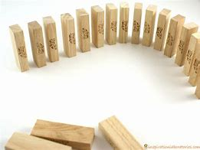
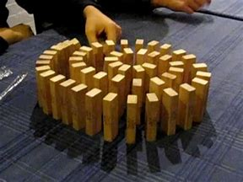
Jenga/dominoes Race!
In small groups you must line up your Jenga blocks/dominos.
They must be close enough together to be able to fall if pushed.
If your blocks get knocked down you must start again.
The first team to line up all their blocks wins.
Do not touch anyone else’s blocks.
Good luck!!!

Slide 2
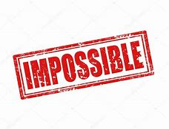
You must now try to knock down the Jenga/domino blocks BUT there are rules.......
You MUST NOT
Touch ANY blocks with ANYTHING (this includes blowing)
Touch the table, chairs or surrounding area.
Stamp, or move about aggressively near the blocks.
Good luck!!
?

Slide 3
The mandatory content
Existence of God mandatory content.
Does God exist?
. What arguments/theories do religious people use to prove the existence of God?
. What evidence do religious people use to support these arguments/theories?
. What are the strengths and weaknesses of evidence/arguments/theories?
. What arguments/theories do non-religious people use to challenge the existence of God?
. What evidence do non-religious people use to support these arguments/theories?
. What are the strengths and weaknesses of evidence/arguments/theories?
. Can either religious or non-religious arguments/theories provide conclusive proof about the existence of God?

Slide 4

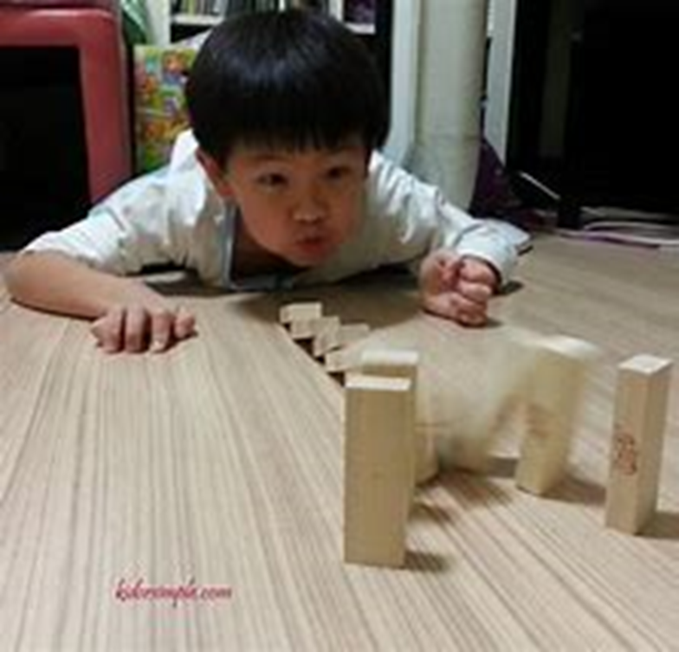
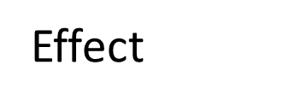

The impossible mission
The mission was impossible because.
For the blocks to fall something has to happen to cause the process.
Cause
There must be a cause

Slide 5
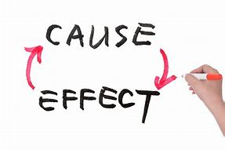
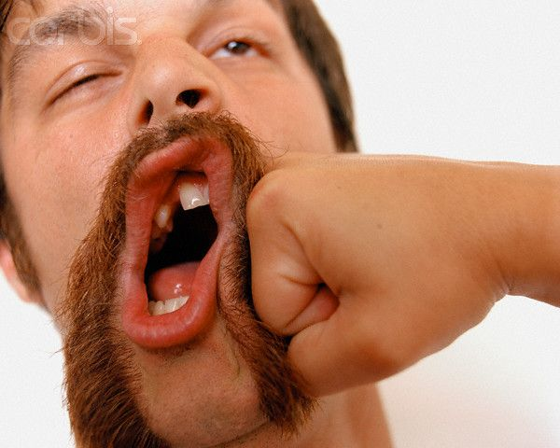
In fact it could be argued that everything that happens has a cause and a subsequent effect.
This is true of events and emotions and actual objects.
Nothing simply just appears or happens, something has caused it into being.
Effect
Cause

Slide 6
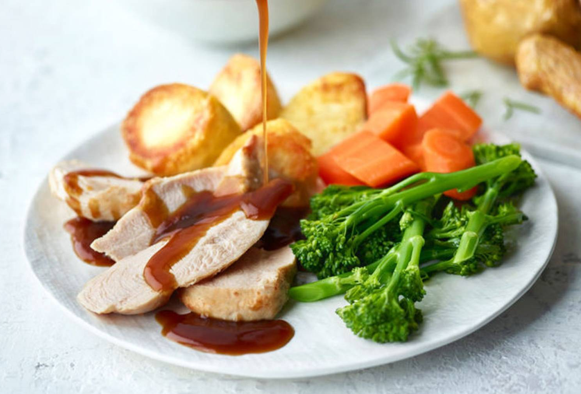
Lets think of an example:
Think of a Roast Chicken meal.
What caused it into being?
Think of each element.
What were all the different events that needed to happen to get that chicken/roast potatoes/carrots/broccoli/gravy onto your plate?
Chicken Dinner: Cause and effect
In the back of your jotters make a list of the process that caused this burger.

Slide 7
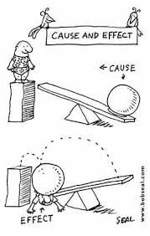
The cause and effect argument is fundamental in understanding the cosmological argument.

Slide 8
The Cosmological argument
. Also known as the “first cause argument” or the “argument from causation.”
Cosmology means “study of the origins of the universe.”
So the Cosmological Argument is based on the idea that by studying the universe and the origins of it the idea of God can be proved.
This is based on the idea of cause and effect and is one of the oldest arguments for trying to prove God’s existence.
One of the most famous versions of the cosmological argument was put forward by a man named St Thomas Aquinas.

Slide 9
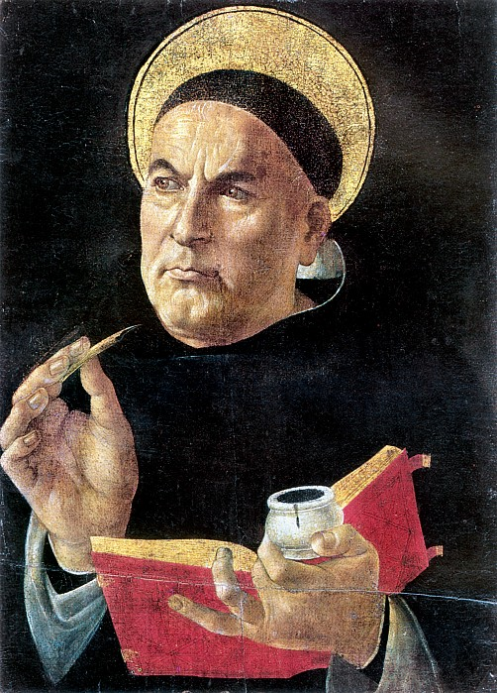
Saint Thomas Aquinas
St Thomas Aquinas (1224-1274).
Italian, born onto a wealthy family.
Rejected wealth and became a member of the Dominican religious order.
Deep thinker, theologian and author.
He believed that the Natural World provided a lot of evidence for God’s existence.

Slide 10
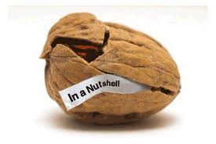
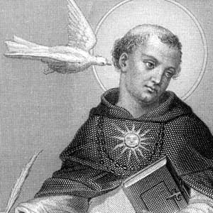
Aquinas argued that every effect must have a cause and that string of effects must have started somewhere. KU
If you track things back through a series of causes, there must have been a 'first cause’. KU
He said that this 'first cause' is God, whom he described as a 'necessary being‘ or ‘the uncaused cause’ who exists outside of our space and time but is able to act within it, needing no explanation and having no cause. KU

